Slide 1
LOAN PREDICTION USING MACHINE LEARNING
Batch No: 14P57
K. Spandana (14321A0589)
G. Sravanthi (14321A0590)
Internal Guide: Mrs. Usha Rani K
CSE-B Coordinator: Mrs. Jhansi Rani M

Slide 2
Contents
Introduction
Requirements Analysis
Design
Implementation
Test Cases
Screen Shots
References
Conclusion

Slide 3
Introduction
Project scope:
Loan prediction is developing for employee of banks to provide quick, immediate and easy way to choose the deserving applicants for sanction of loans.
This is a standalone application developed by mining the Big Data of the previous records of the people to whom the loan was granted before and on the basis of those records/experiences the machine was trained using the machine learning model which give the most accurate result.

Slide 4
Existing system and Disadvantages
Existing system:
With the enhancement in the banking sector lots of people are applying for bank loans but the bank has its limited assets which it has to grant to limited people only, so finding out to whom the loan can be granted which will be a safer option for the bank is a typical process.
Disadvantages:
Today many banks/financial companies approves loan after a regress process of verification and validation but still there is no surety whether the chosen applicant is the deserving right applicant out of all applicants.

Slide 5
Proposed system and Advantages
Proposed system:
Loan prediction is developed for employee of banks to provide quick, immediate and easy way to choose the deserving applicants for sanction of loans.
This is a standalone application developed by mining the Big Data of the previous records of the people to whom the loan was granted before and on the basis of those records/experiences the machine was trained using the machine learning model which give the most accurate result.
Advantages:
This system reduces the risk factor behind selecting the safe person so as to save lots of bank efforts and assets using machine learning model which gives the most accurate result.

Slide 6
Requirement Analysis
Functional Requirements:
Modules:
1. Data exploration: Understanding the data attribute and categorizing them into their respective data type. i.e categorical and numerical.
2. Data collection: Input data sets are collected depending on the attributes of data required to predict the outcome.
3. Data Preprocessing: Removal of noise or outliers, collecting necessary information to model or account for noise ,strategies for handling missing data fields and accounting for time sequence information and known changes.

Slide 7
4. Model building: After the operation of developing a model based on linear regression model and logistic regression model to predict the approval of loan based on the income levels of the person, family status and his previous loan transactions ,the model predicts whether the new applicant is a fit case for approval of the loan or not based upon the inference it conclude on the basis of the training data sets.
5. Test model: The training data set is now supplied to machine learning model, on the basis of the data set the model is trained. The output obtained by the model is verified with the actual predicted output.
6. Final Report: Based on accuracy of model, the model which gives higher accuracy will be considered for deployment or report generation.

Slide 8
Requirement Analysis
Non Functional Requirements:
Accuracy : This model gives most accurate result.
Portability : It is a standalone application which can be
deployed on different operating systems.
Sensitivity : The output is more sensitive to the training data. The result depends upon the input data and changes when the input changes.

Slide 9
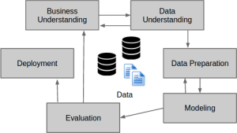
Data Flow Diagram

Slide 10
Requirement Analysis
Hardware Requirements:
Processor : INTEL CORE i3, 1.7 GHz
RAM : 4GB
Hard disk : 40GB
Software Requirements:
Language : R
IDE : R Studio
Datasets : Excel Sheets
Operating System : Windows 10

Slide 11
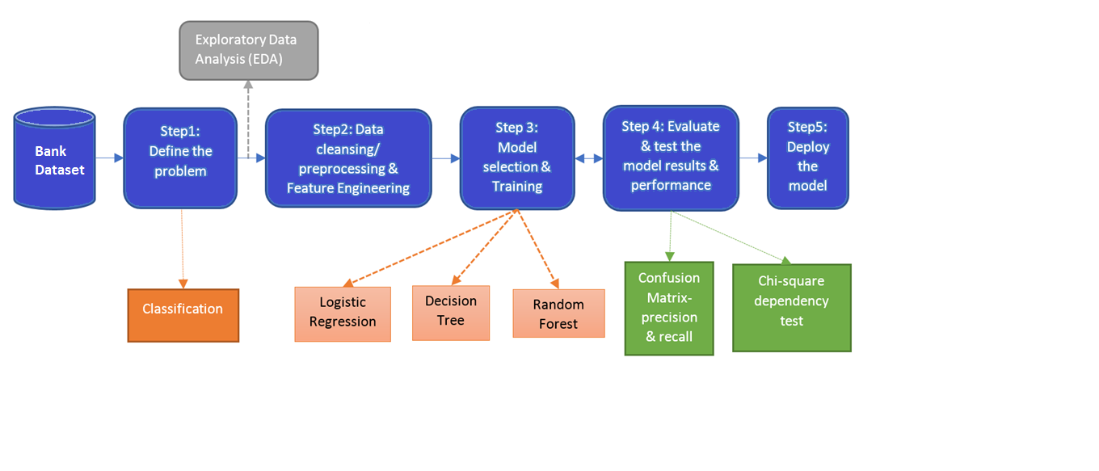
Software Architecture

Slide 12
Technical Architecture
Integrated Development Environment
(IDE)
R Studio
Engine
R
Dataset
Packages
randomForest, rJava, FNN, class, foreach, ada,etc
Libraries
rattle, caret, dplyr, ROCR, etc

Slide 13
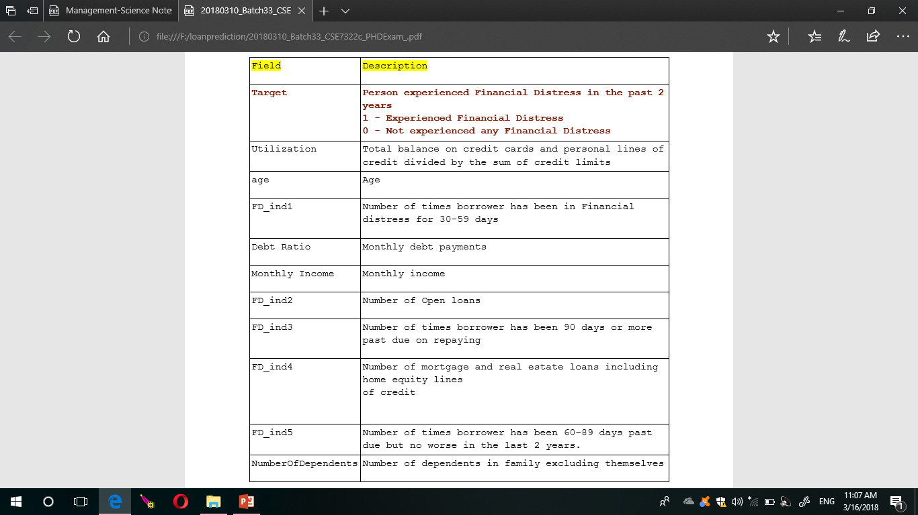
Data Attributes

Slide 14
Pseudo Code
Decision_Tree_C5.0 <- function(data,testdata){
set.seed(12345)
rows = seq(1,nrow(data),1) #to find the no of rows
trainrows = sample(rows,0.7*(nrow(data))) #to take a sample of rows from the training data
train_data = data[trainrows,] #load Training data
test_data = data[-trainrows,] #load testing data other than training data
print("split completed")
library(rpart) #load the library file
DT_C5.0=rpart(Target~.,data=train_data,method="class") #Classification data
plot(DT_C5.0,main="classification Tree for Target",margin=0.15,uniform=TRUE) #ploting the graph
text(DT_C5.0,use.n=T)
summary(DT_C5.0)
#DT_C5.0_prune=rpart(Target ~.,data=train,method=" class", cp=0.001)
#printcp(DT_C5.0_prune)
pred <- predict(DT_C5.0,data = train_data,type = "class") #predict the output from training data
library(caret) #load the library file

Slide 15
s = confusionMatrix(pred,train_data$Target,positive = "1") #create confusion matrix for training data
print(s)
pred <- predict(DT_C5.0,newdata = test_data,type = "class") #predict out for testing data
library(caret)
s = confusionMatrix(pred,test_data$Target,positive = "1") #create confusion matrix for testing data
print(s)
########predict on unseen data
testdata$Target <- predict(DT_C5.0, newdata = testdata,type = "class")
testdata<- testdata[,c("ID","Target")]
write.csv(testdata,file = "Submission_DT_cart.csv",row.names = F) #display the output in csv file
return(testdata)
}

Slide 16
Test Cases
Test Case | Description | Input | Actual Output | Expected output | Result
1 | Packages | Training and Testing data | randomForest package is not found | randomForest package is not found | Test passed
2 | Training data | Testing data | Training data not found | Training data not found | Test passed
3 | Testing data | Training data | Testing data not found | Testing data not found | Test passed
4 | Libraries | Training and Testing data | caret is not installed | caret library is not installed | Test passed
5 | Data set not present in the current working directory | Training and Testing data | Variable train not available | Train data not available | Test passed

Slide 17
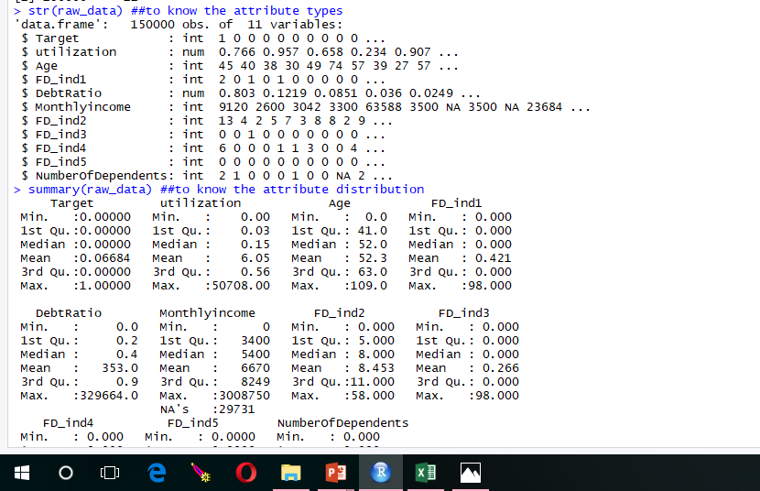
Screen Shots
Data attributes in the data frame and their data types

Slide 18
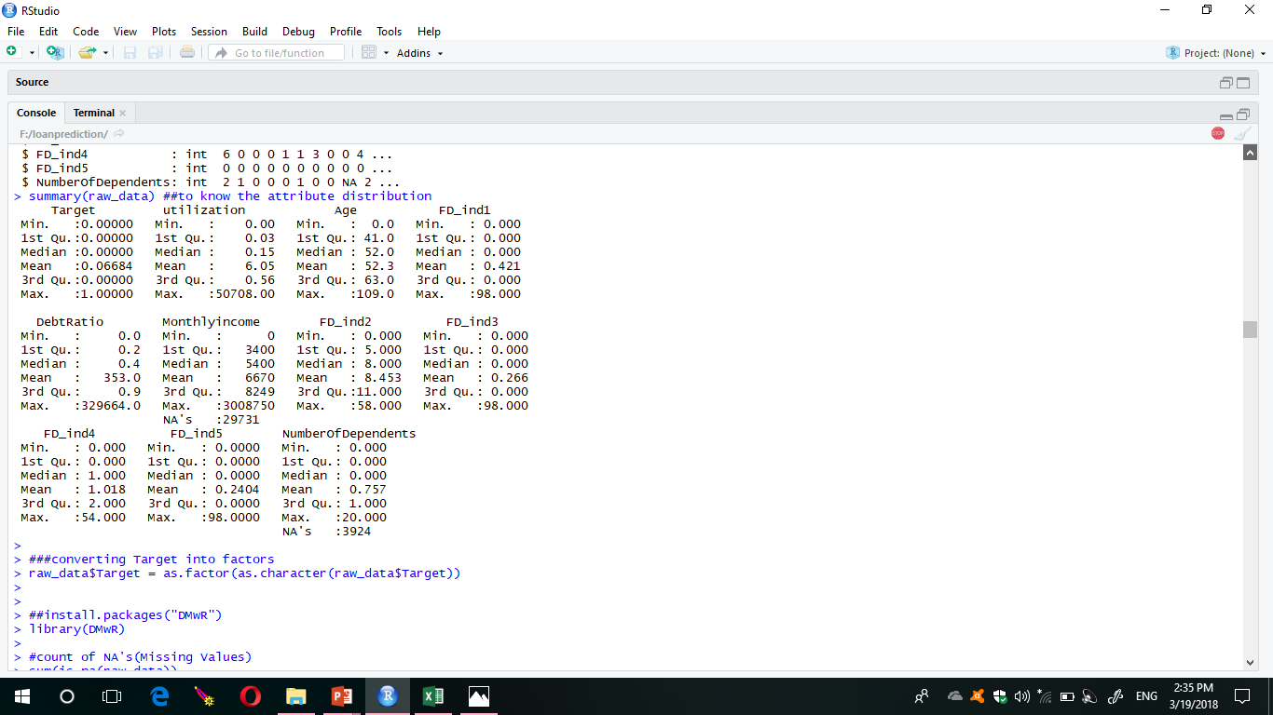
Summary of attribute distribution

Slide 19
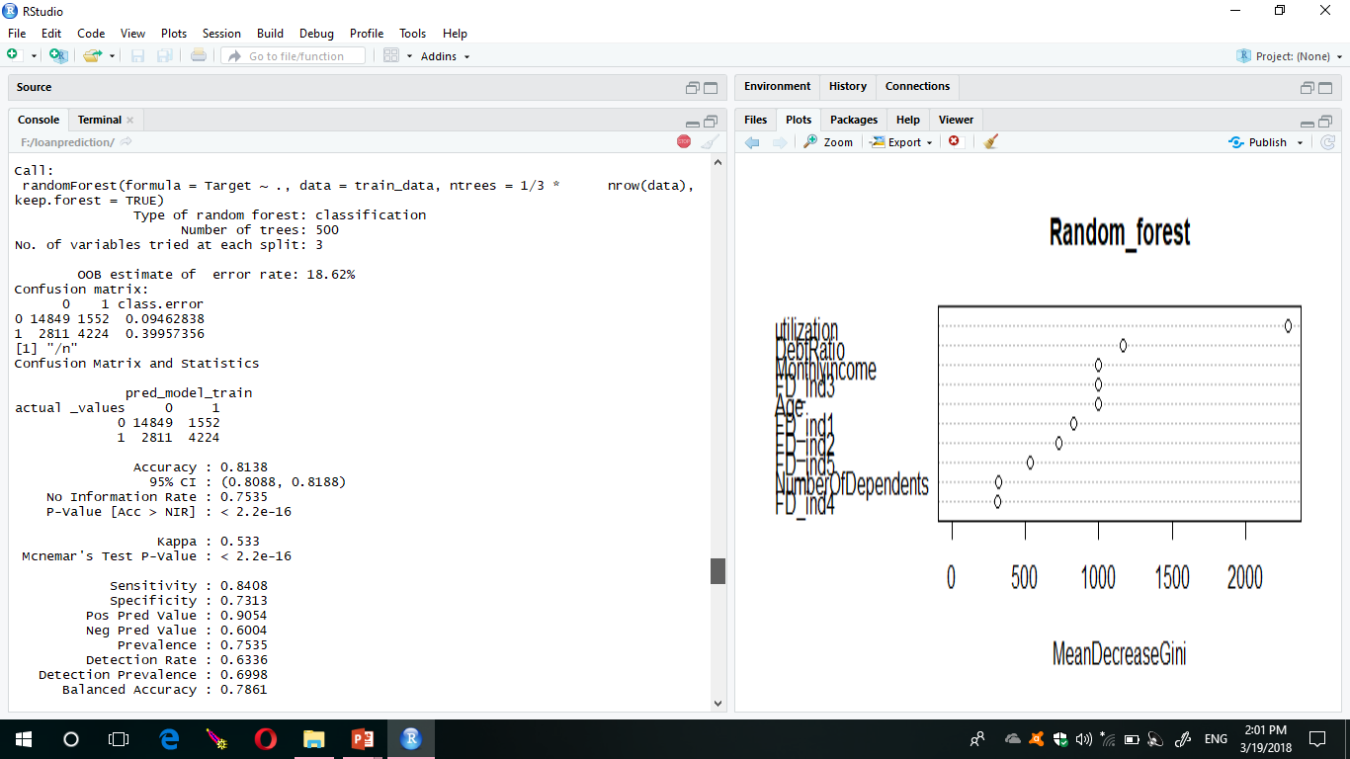
Random Forest for training data

Slide 20
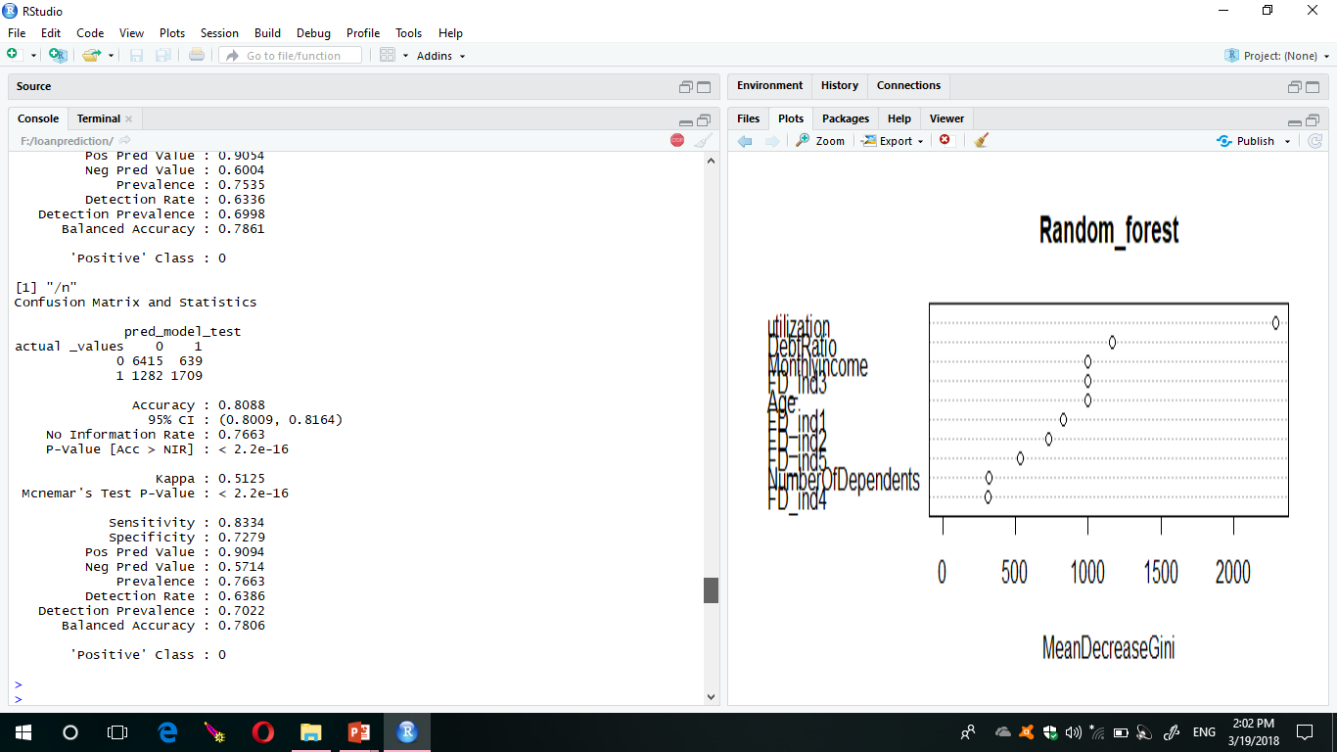
Random Forest for testing data

Slide 21
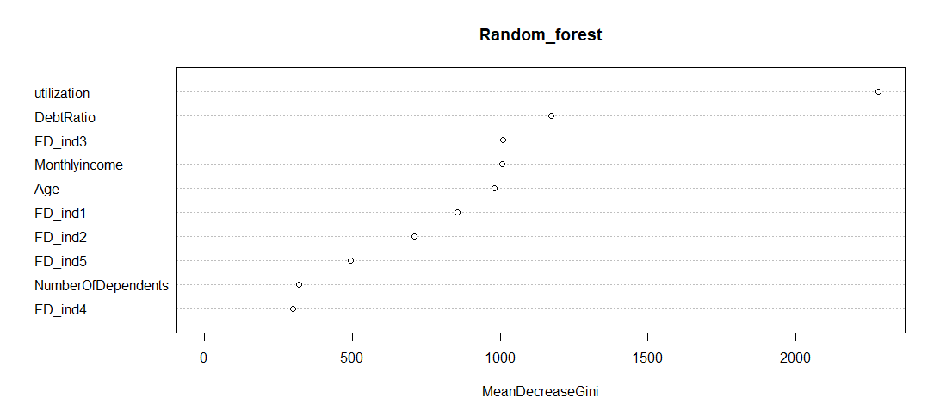
Plot of Random Forest

Slide 22
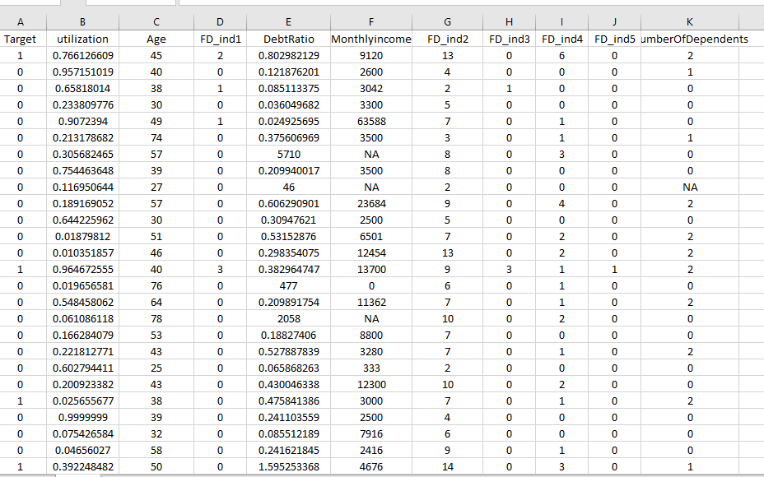
Training Data

Slide 23
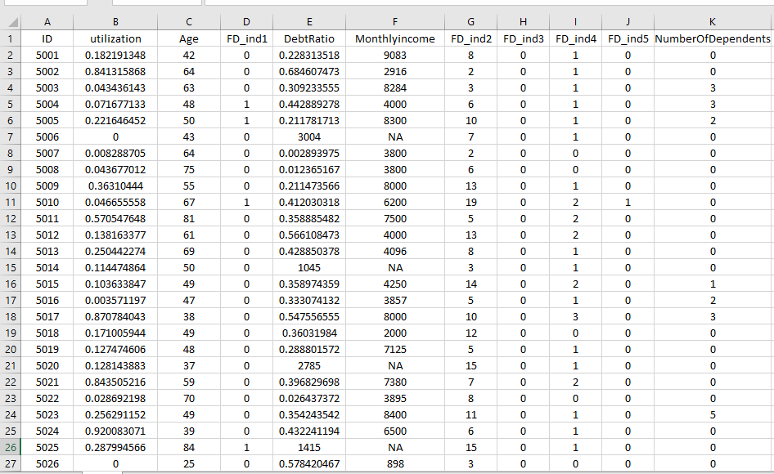
Testing Data

Slide 24
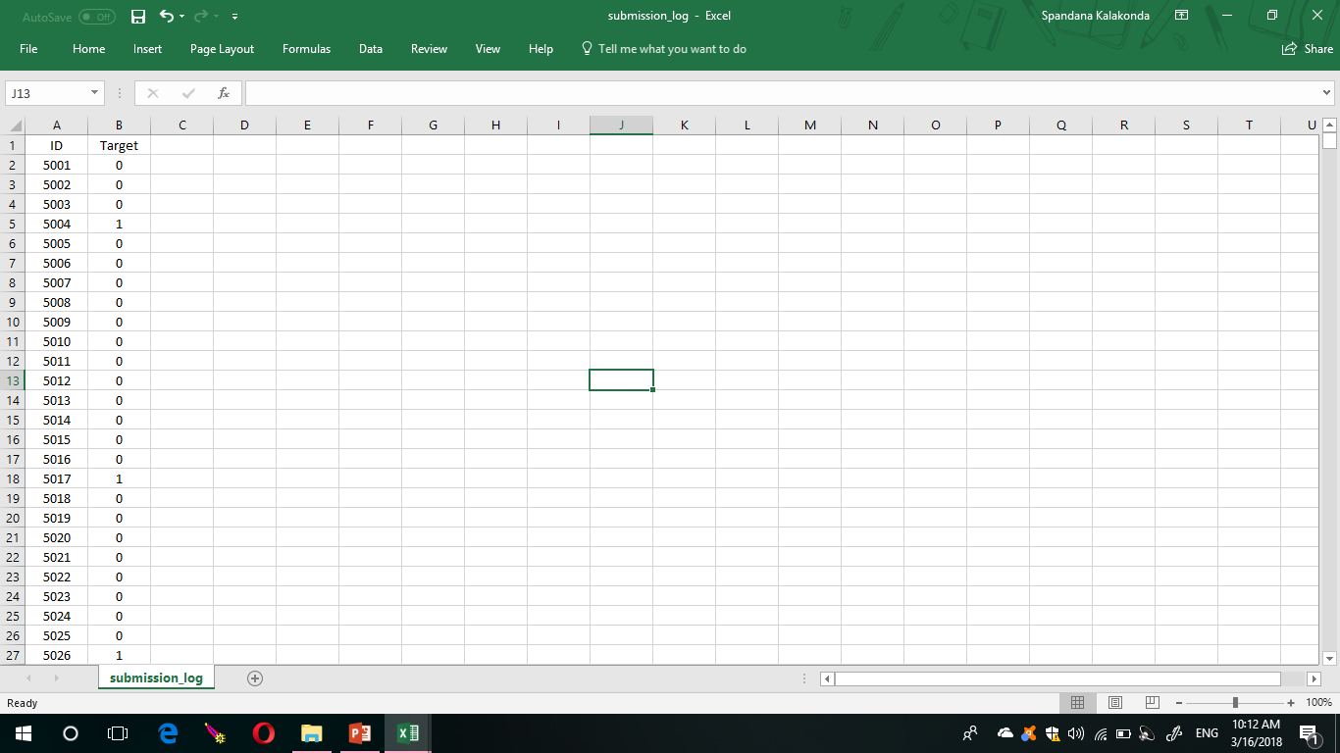
Output

Slide 25
References
Rattle data mining tool: available from http://rattle.togaware.com/rattle-download.html.
Aafer Y, Du W &Yin H 2013, DroidAPIMiner: ‘Mining API-Level Features for Robust Malware Detection in Android’, in: Security and privacy in Communication Networks Springer, pp 86-103 .
Ekta Gandotra, Divya Bansal, Sanjeev Sofat 2014, ‘Malware Analysis and Classification: A Survey’available from http:// www.scirp.org/journal/jis

Slide 26
Conclusion
Loan approval prediction is in the process of development for bank employees to provide quick, immediate and easy way to choose the deserving applicants for sanction of loans.
This component can be easily plugged in many other systems.

Slide 27



